Slide 1

Assessing the Economic, Environmental, and Public Engagement Impacts of the Kentucky Logging Bridge Program
Michael J Ammerman – University of Kentucky Forestry Extension Associate

Slide 2





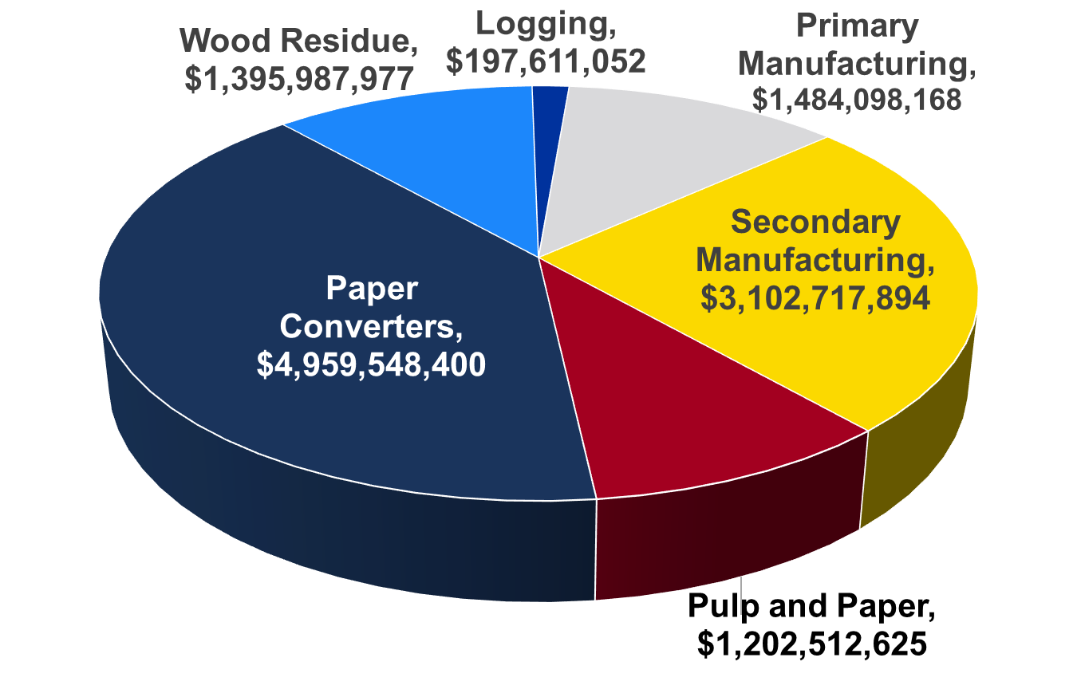

Economic Impacts for the State
2024 Estimate
Total: $18.278 billion
Direct: $12.342 billion
Change from 2023
Direct: -1.49%
Total: -1.54%

Slide 3
Minimum Crossing Requirements
MR 1.6 - Where economically and/or topographically feasible, ELEVATED CROSSINGS (ex. Bridges, culverts, pole crossings, etc.) shall be used when crossing streams (perennial and intermittent) and ephemeral channels.
Immediately stabilize disturbed ground associated with crossing (excluding the active trail or road surface) to reduce runoff into streams

Slide 4
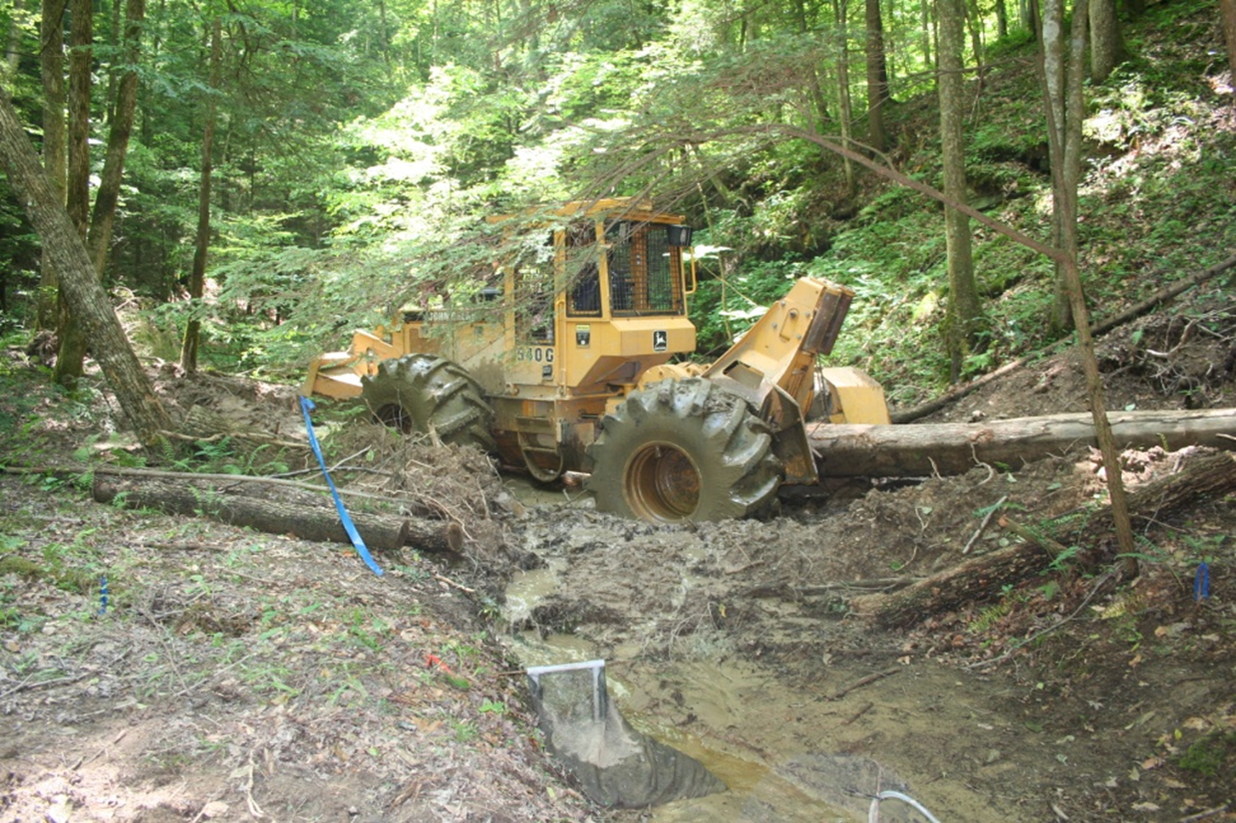
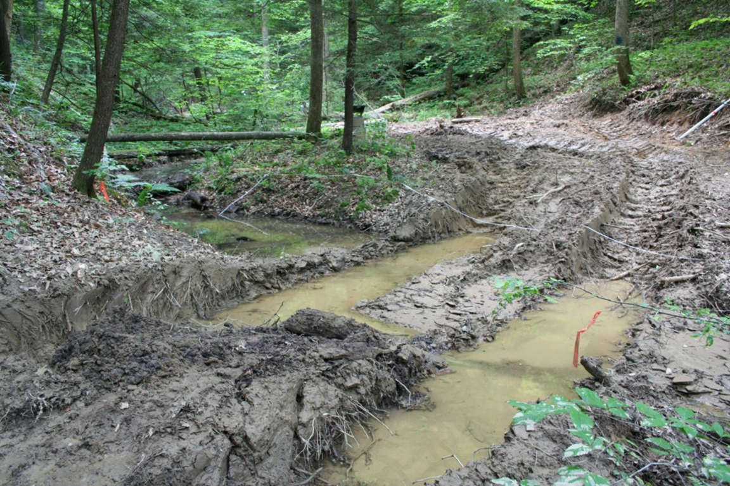
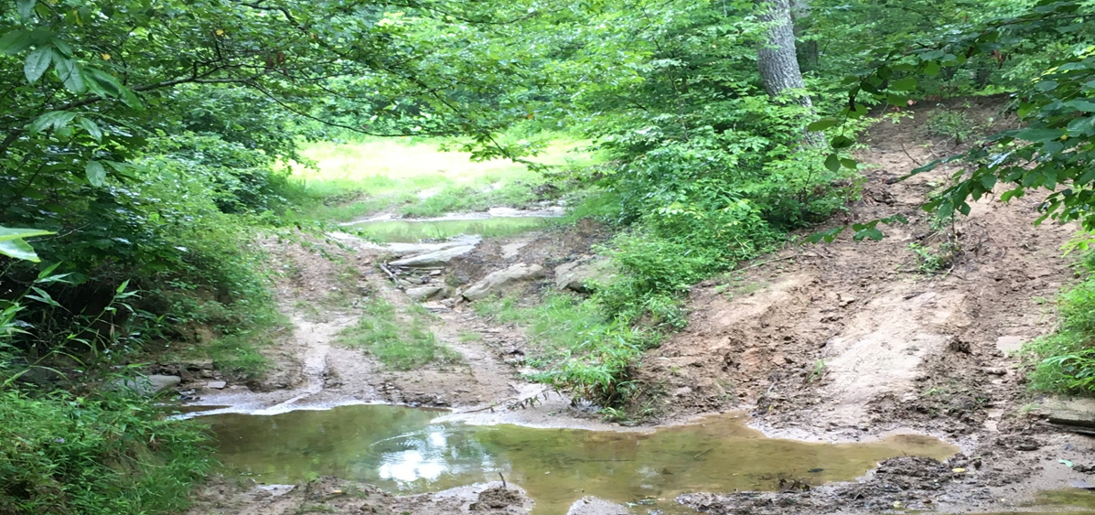
Bad Crossings
Sediment is directly put into the stream, and there are no deterrents to prevent sediment from entering the stream.
MR 1.8 - Avoid depositing soil into the stream or channel.

Slide 5
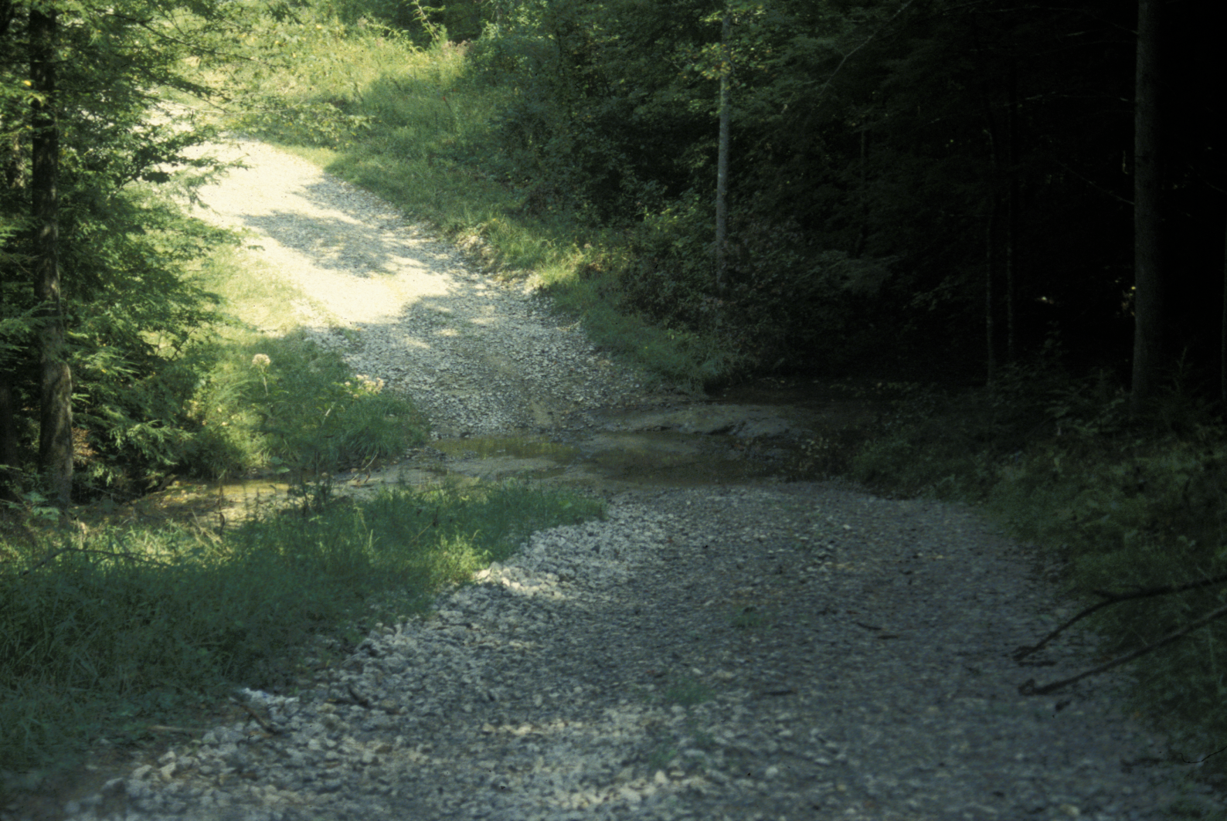
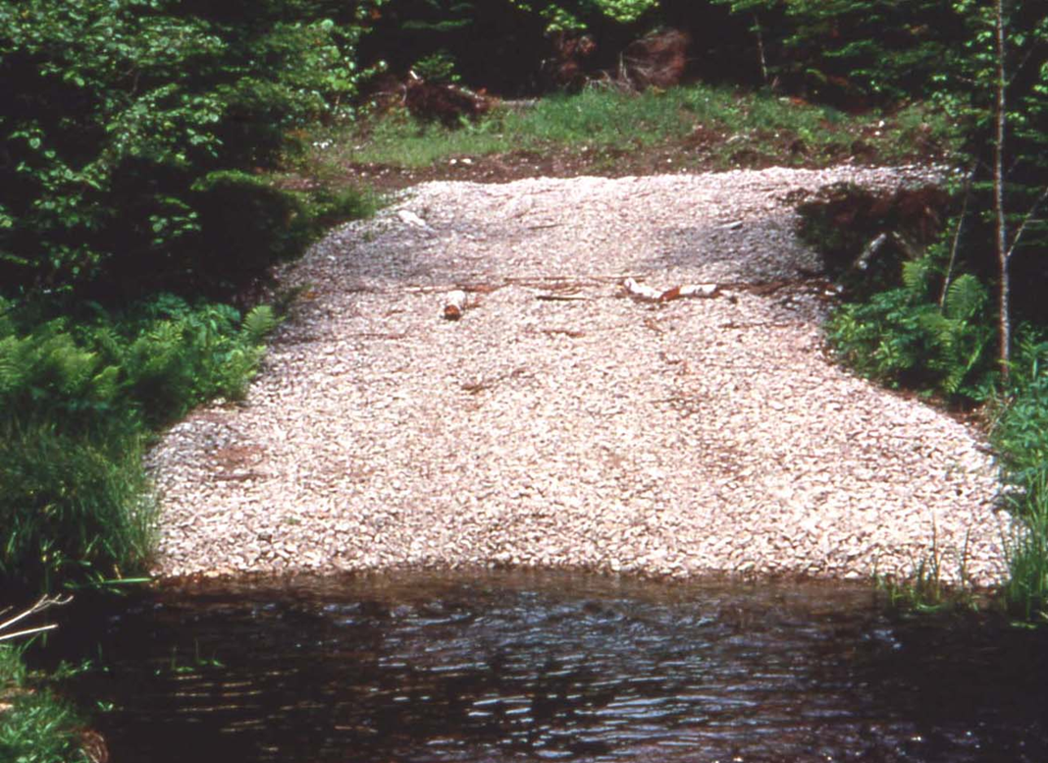
Ford
Must have reinforced bottom and have an armored approach
Can only be used when an elevated stream crossing is impossible

Slide 6
Elevated Stream Crossings
PVC Pipe Bundles
Wooden Bridges
Crane Matts (A form of Wooden Bridges)
Culverts

Slide 7
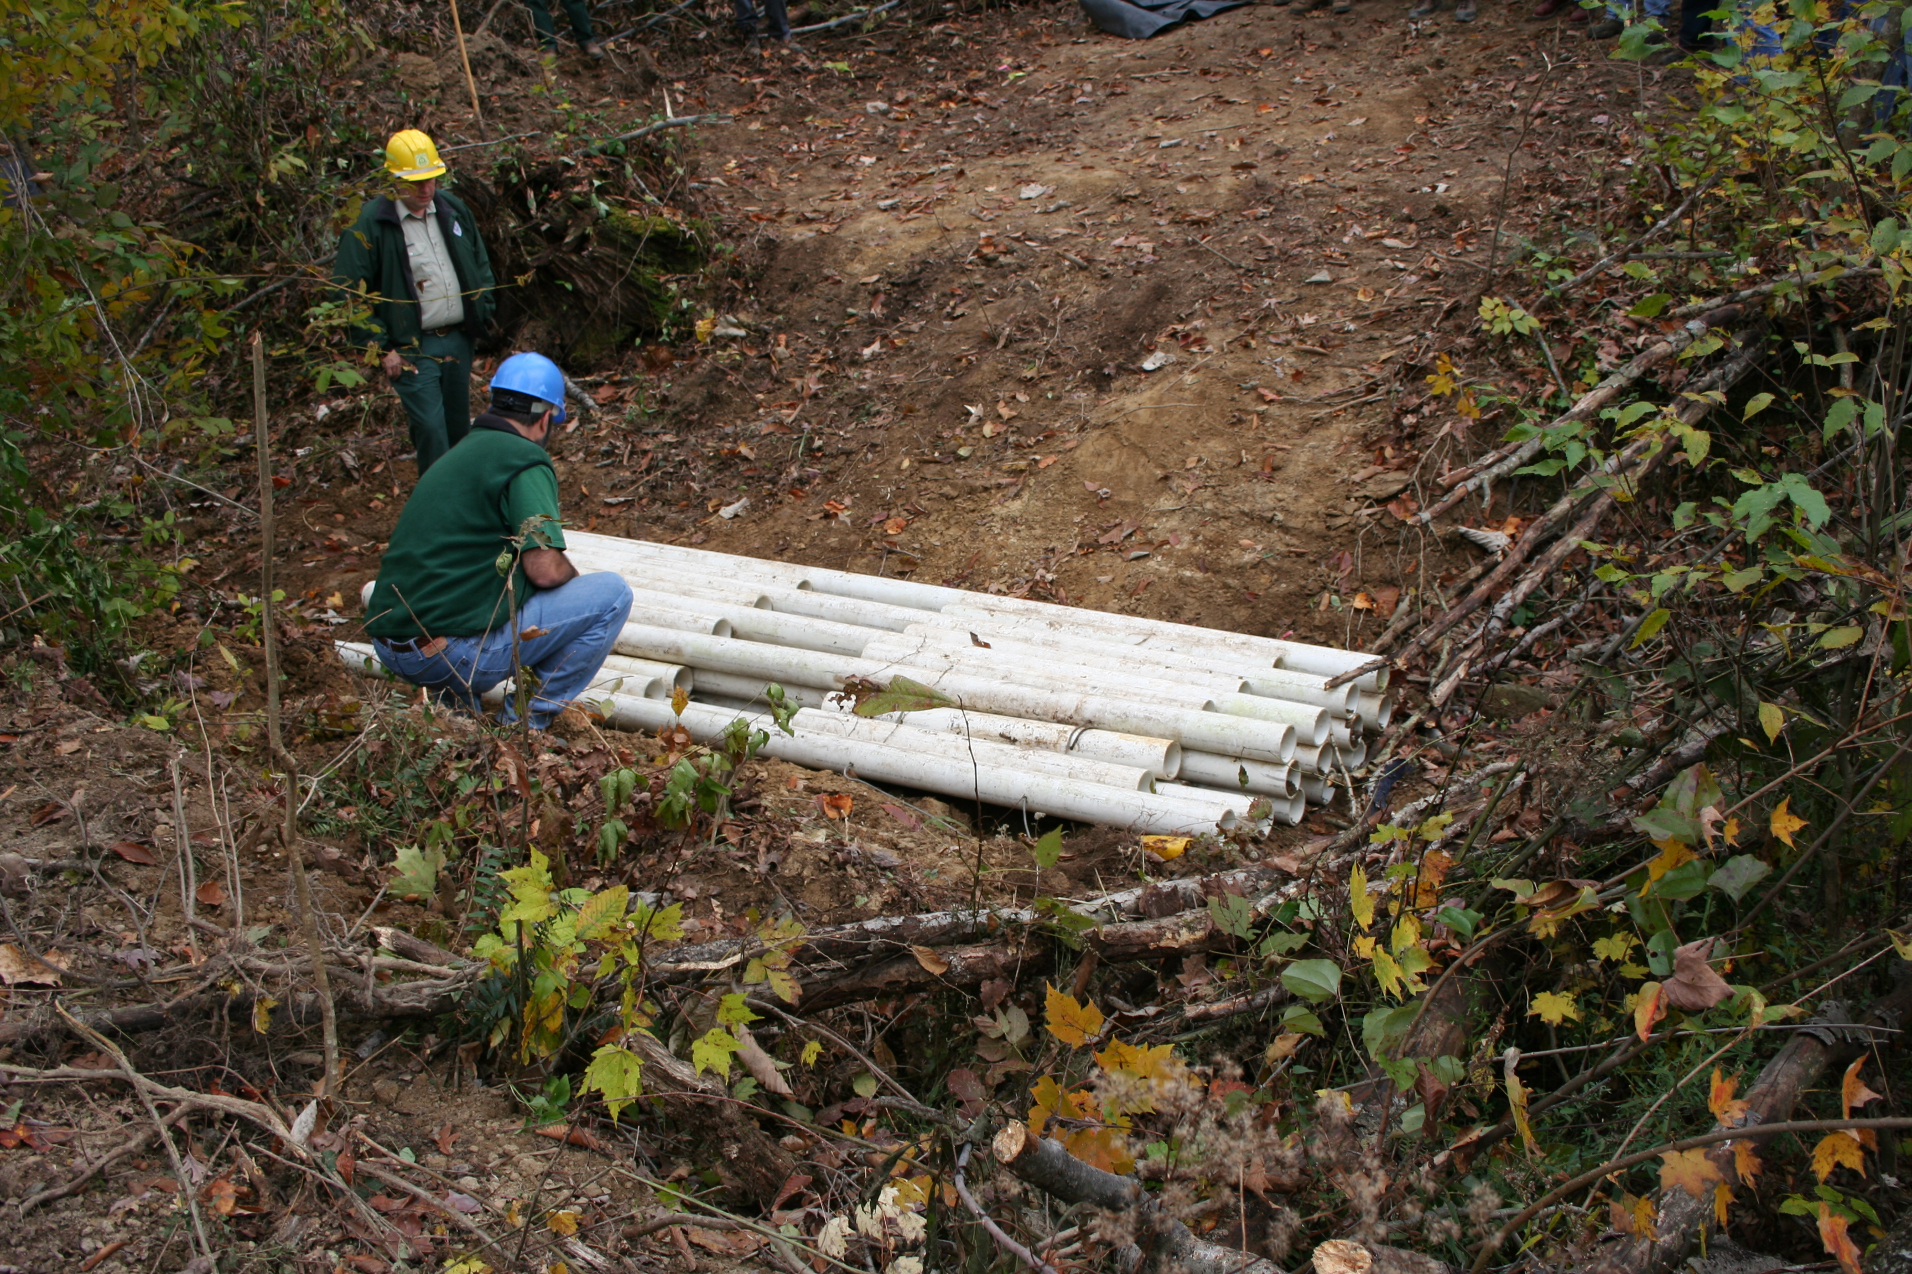
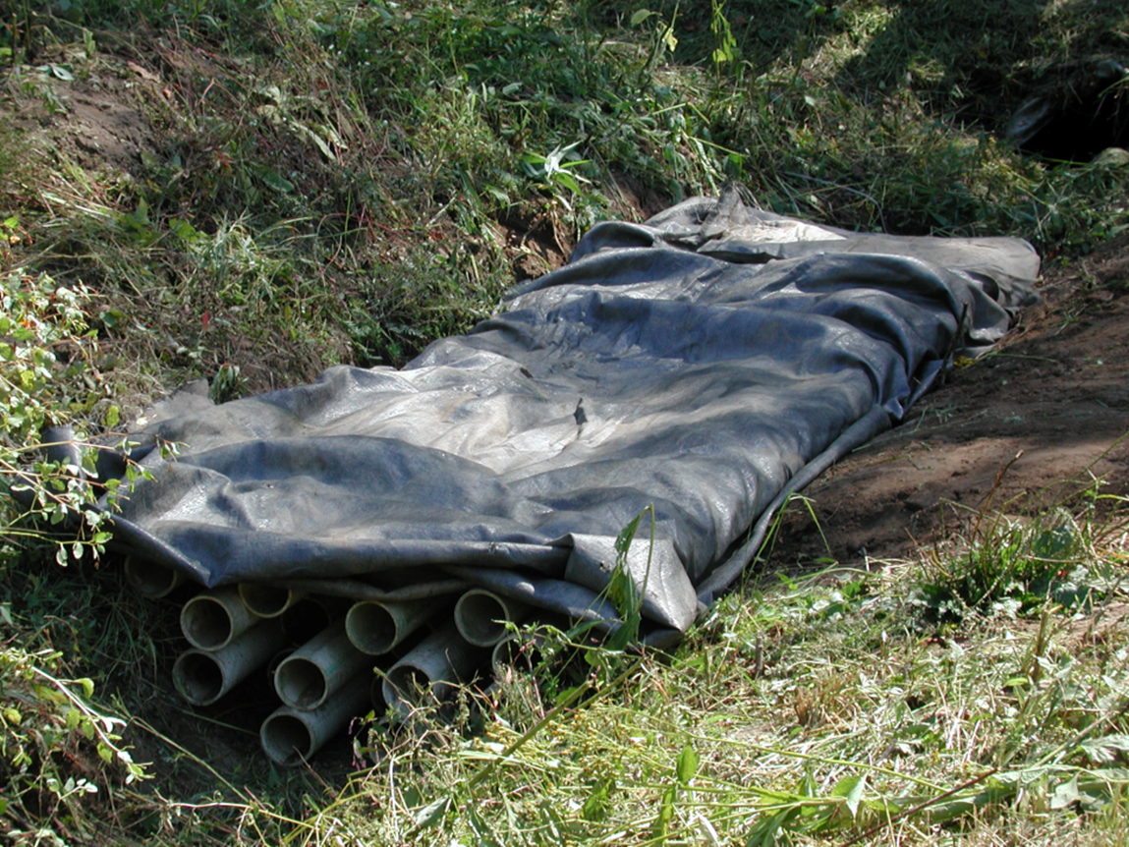
PVC Pipe Bundle

Slide 8
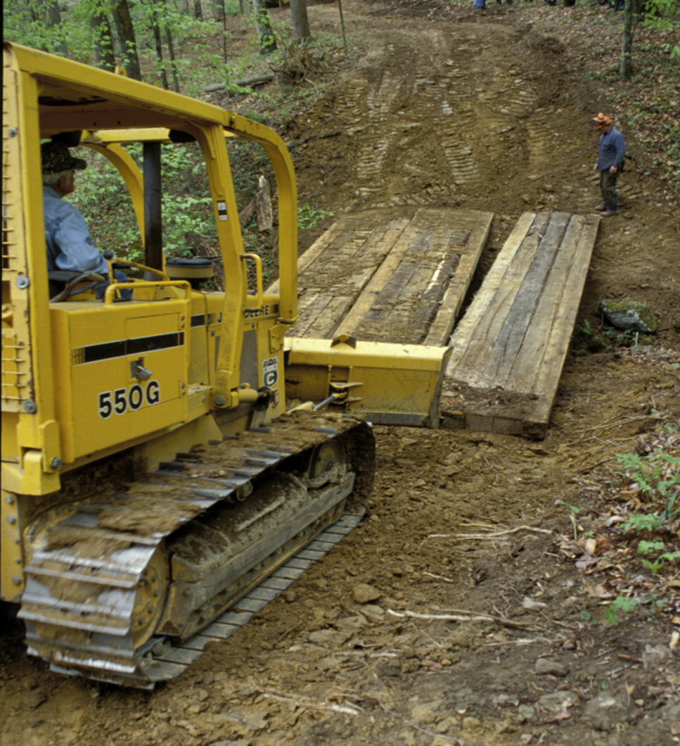
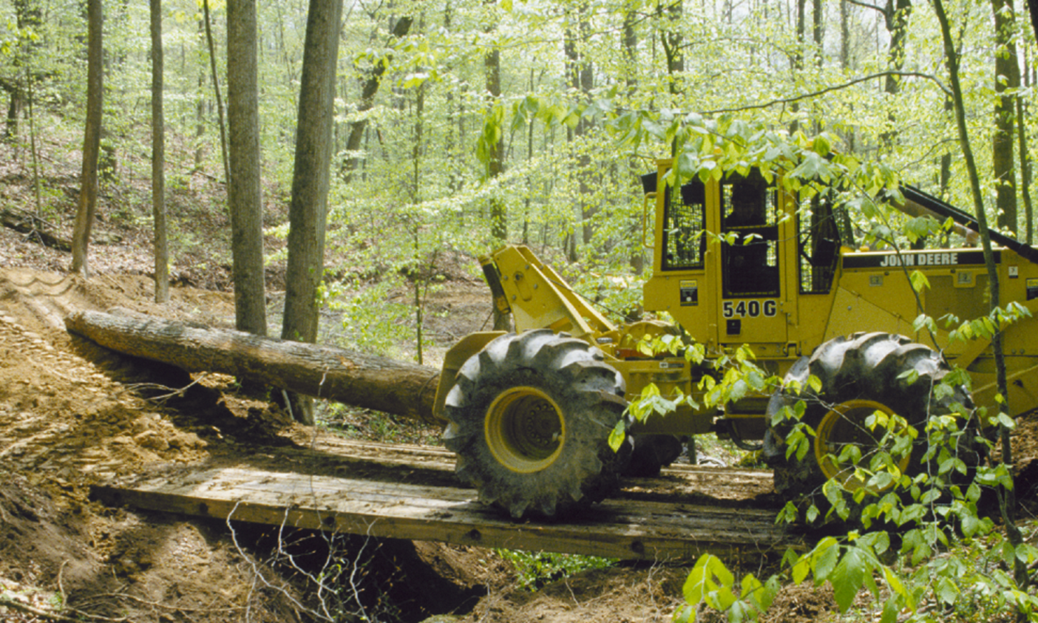
Wooden Bridges

Slide 9
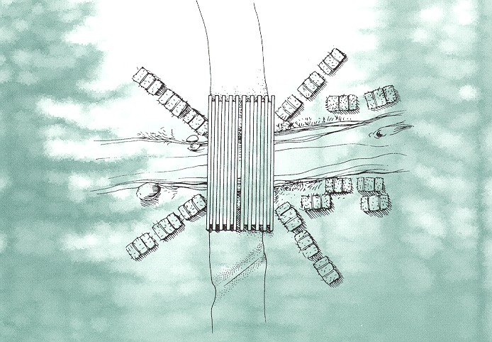
Example of a Good Crossing

Slide 10
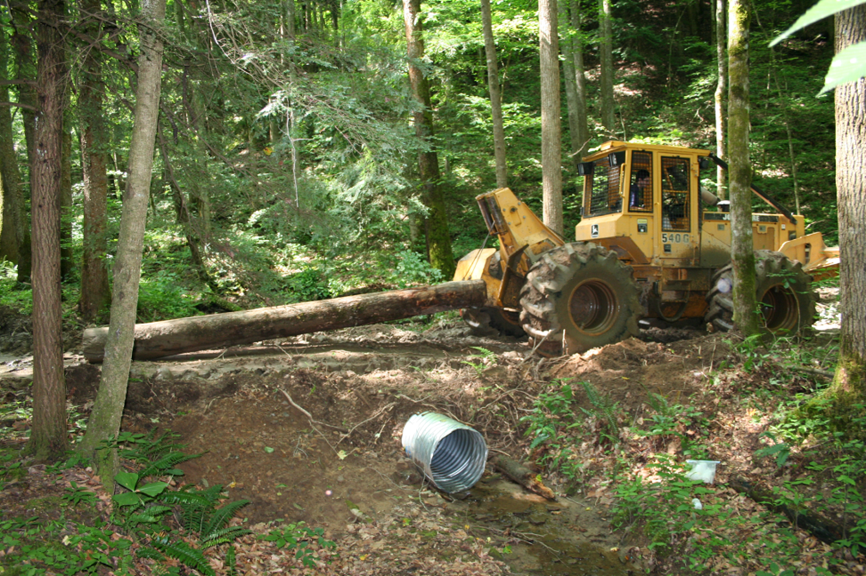
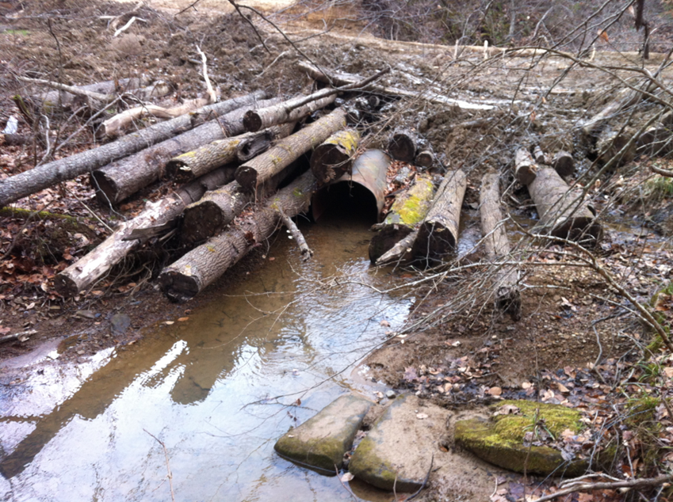
Culverts

Slide 11
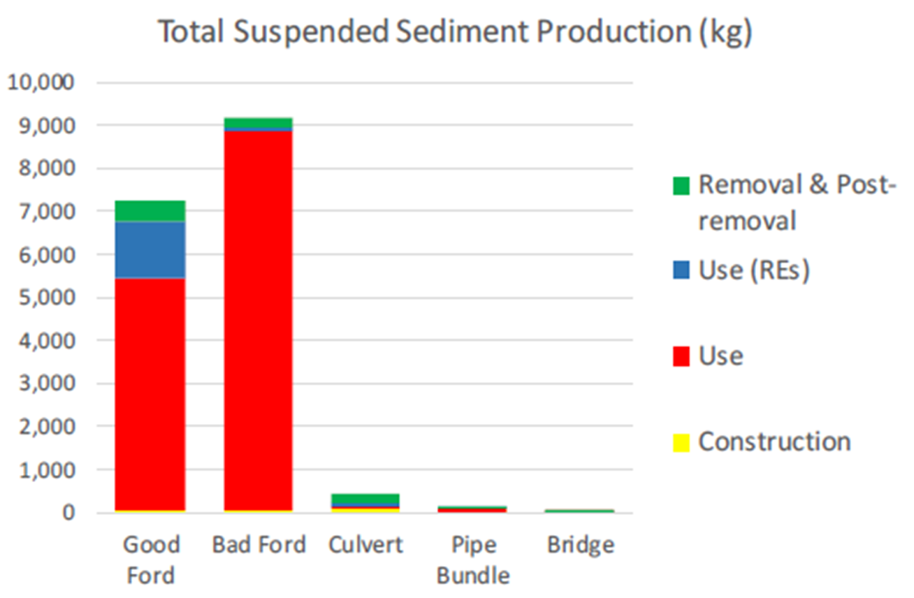
Skidder Crossing (headwater streams)

Slide 12

Kentucky Logging Bridges Program
1.5 - 2 million dollars over three years
Rent to own program
Stationed at the RCARS Wood Center in Jackson KY
Supports water quality
Elevated stream crossings reduce suspended sediment by over 90%
Supports proper SMZ’s for threatened and endangered species

Slide 13
Structure – The Kentucky Logging Bridge Program
We will be offering bridges of varying lengths to loggers at a subsidized cost of 25% the total bridge cost.
Bridge Lengths
18 foot bridges sold at 106 dollars a section or 300 dollars for 3 sections
20 foot bridges sold at 200 dollars a section or 600 dollars for 3 sections
24 foot bridges sold at 300 dollars a section or 800 dollars for 3 section
30 foot bridges will be sold at market rate.
Bridges will be stored at 4 different locations throughout the state

Slide 14
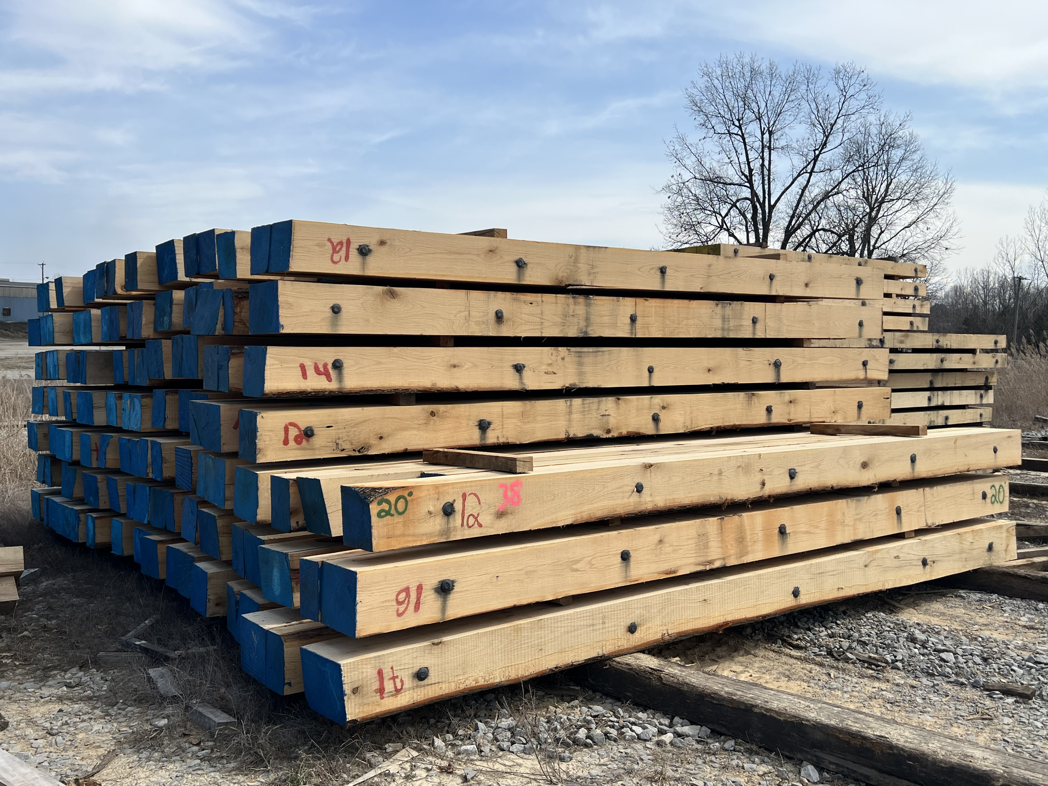
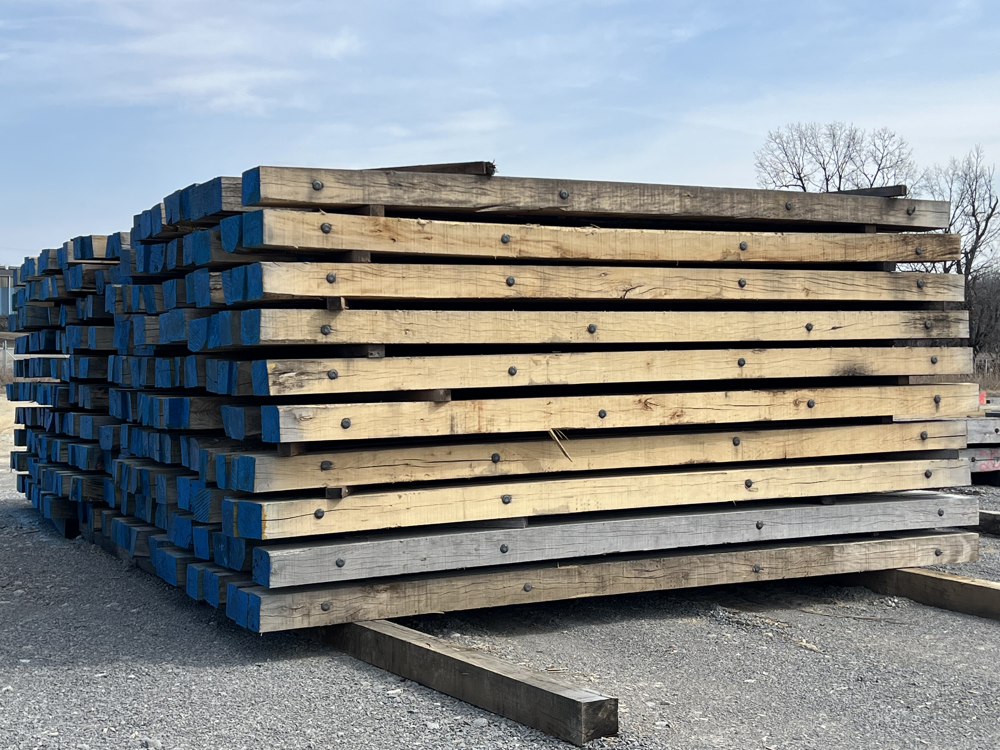
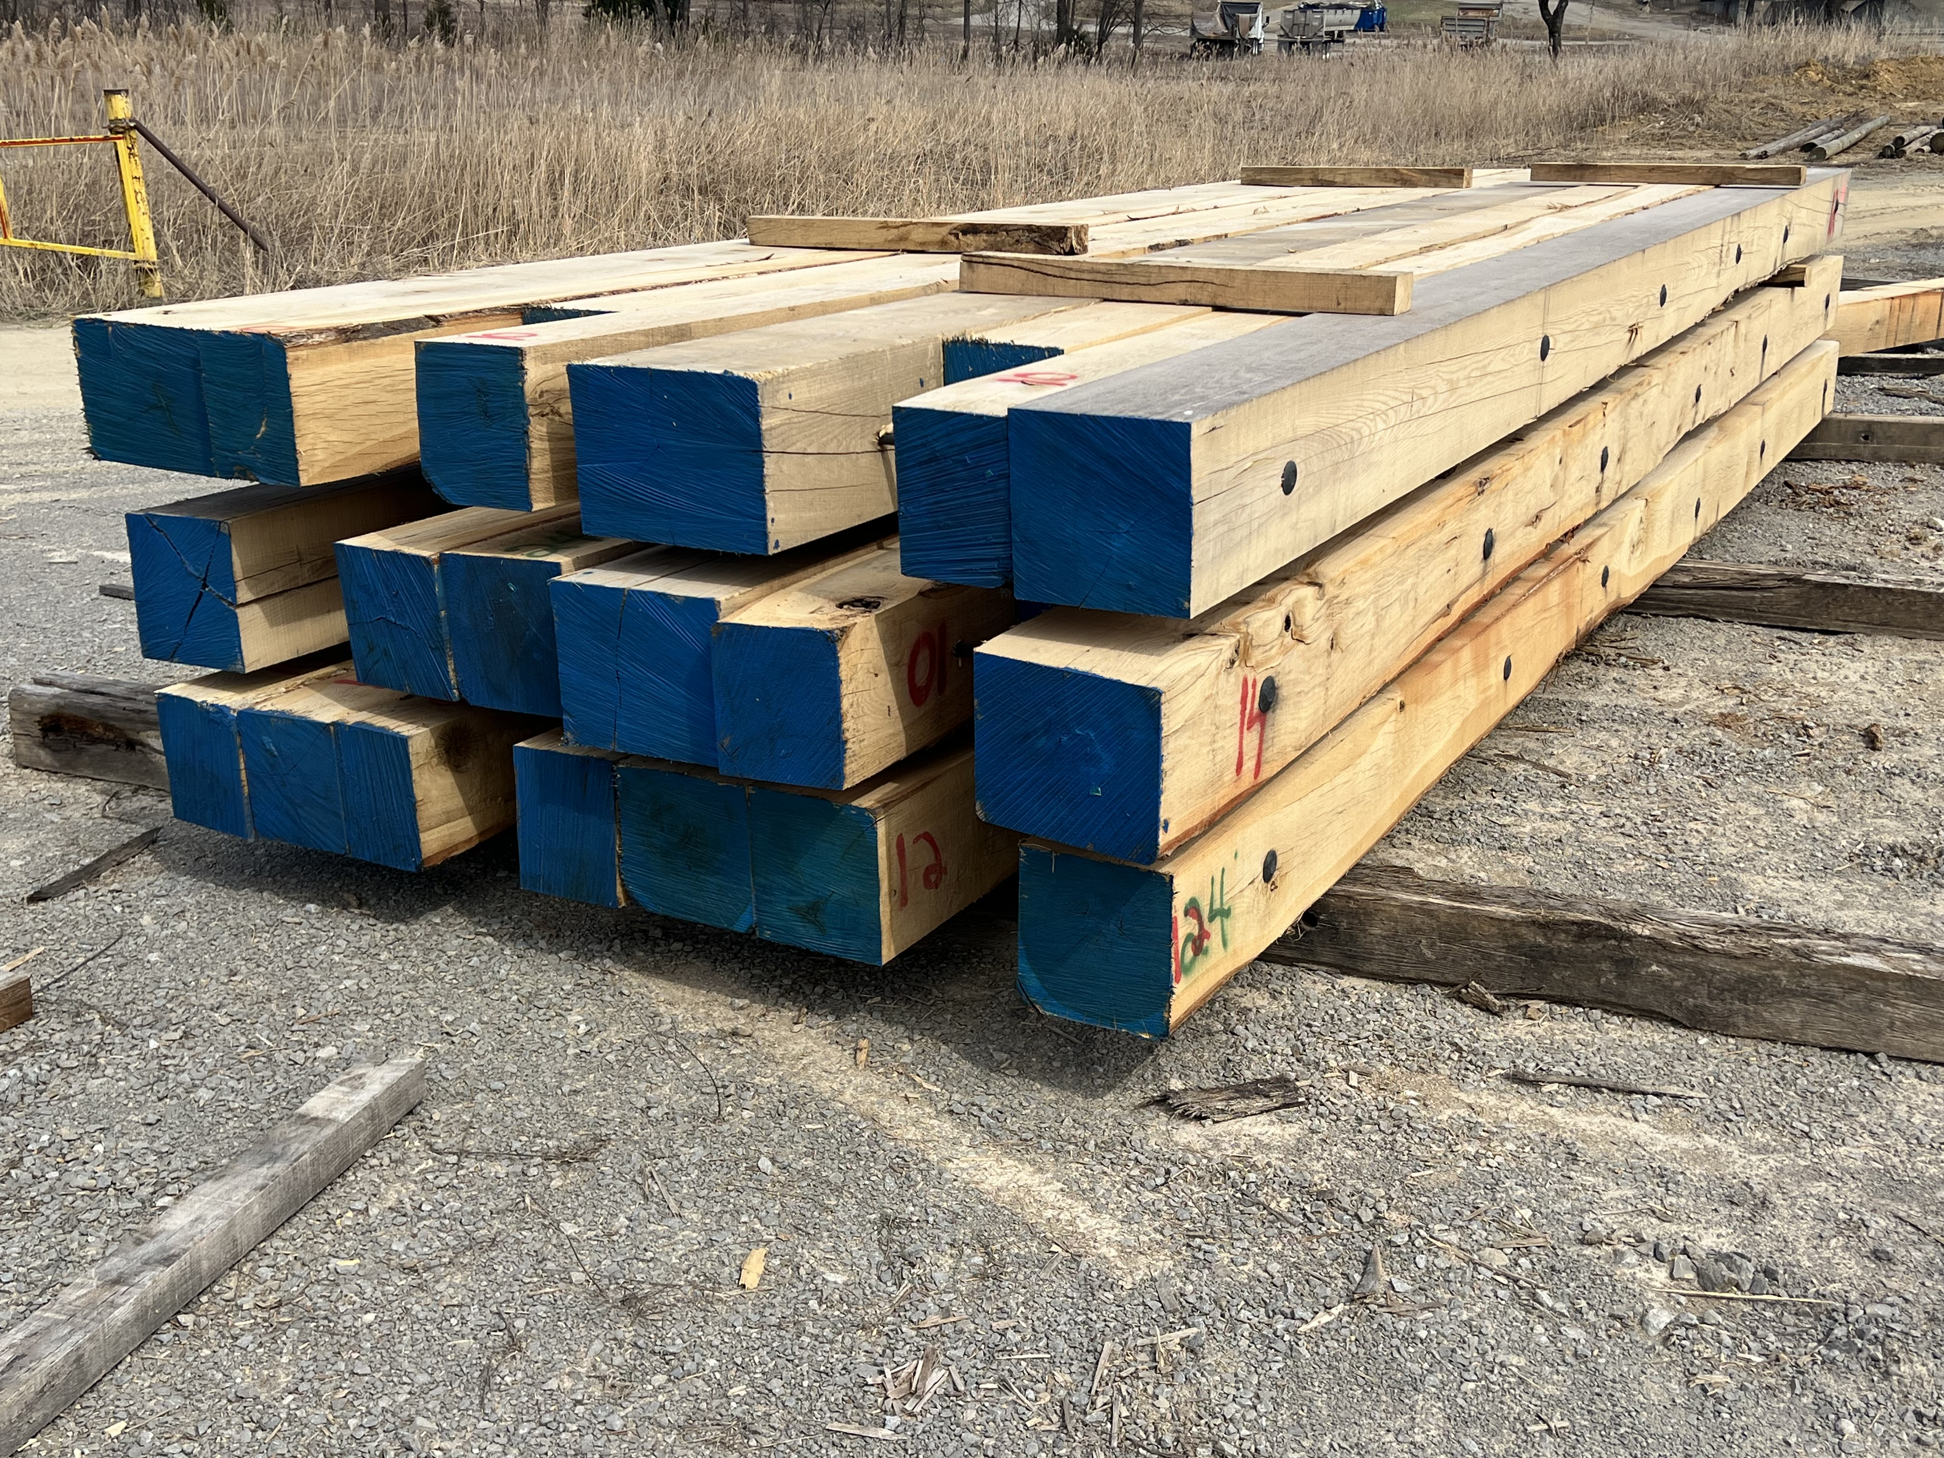
Bridges

Slide 15
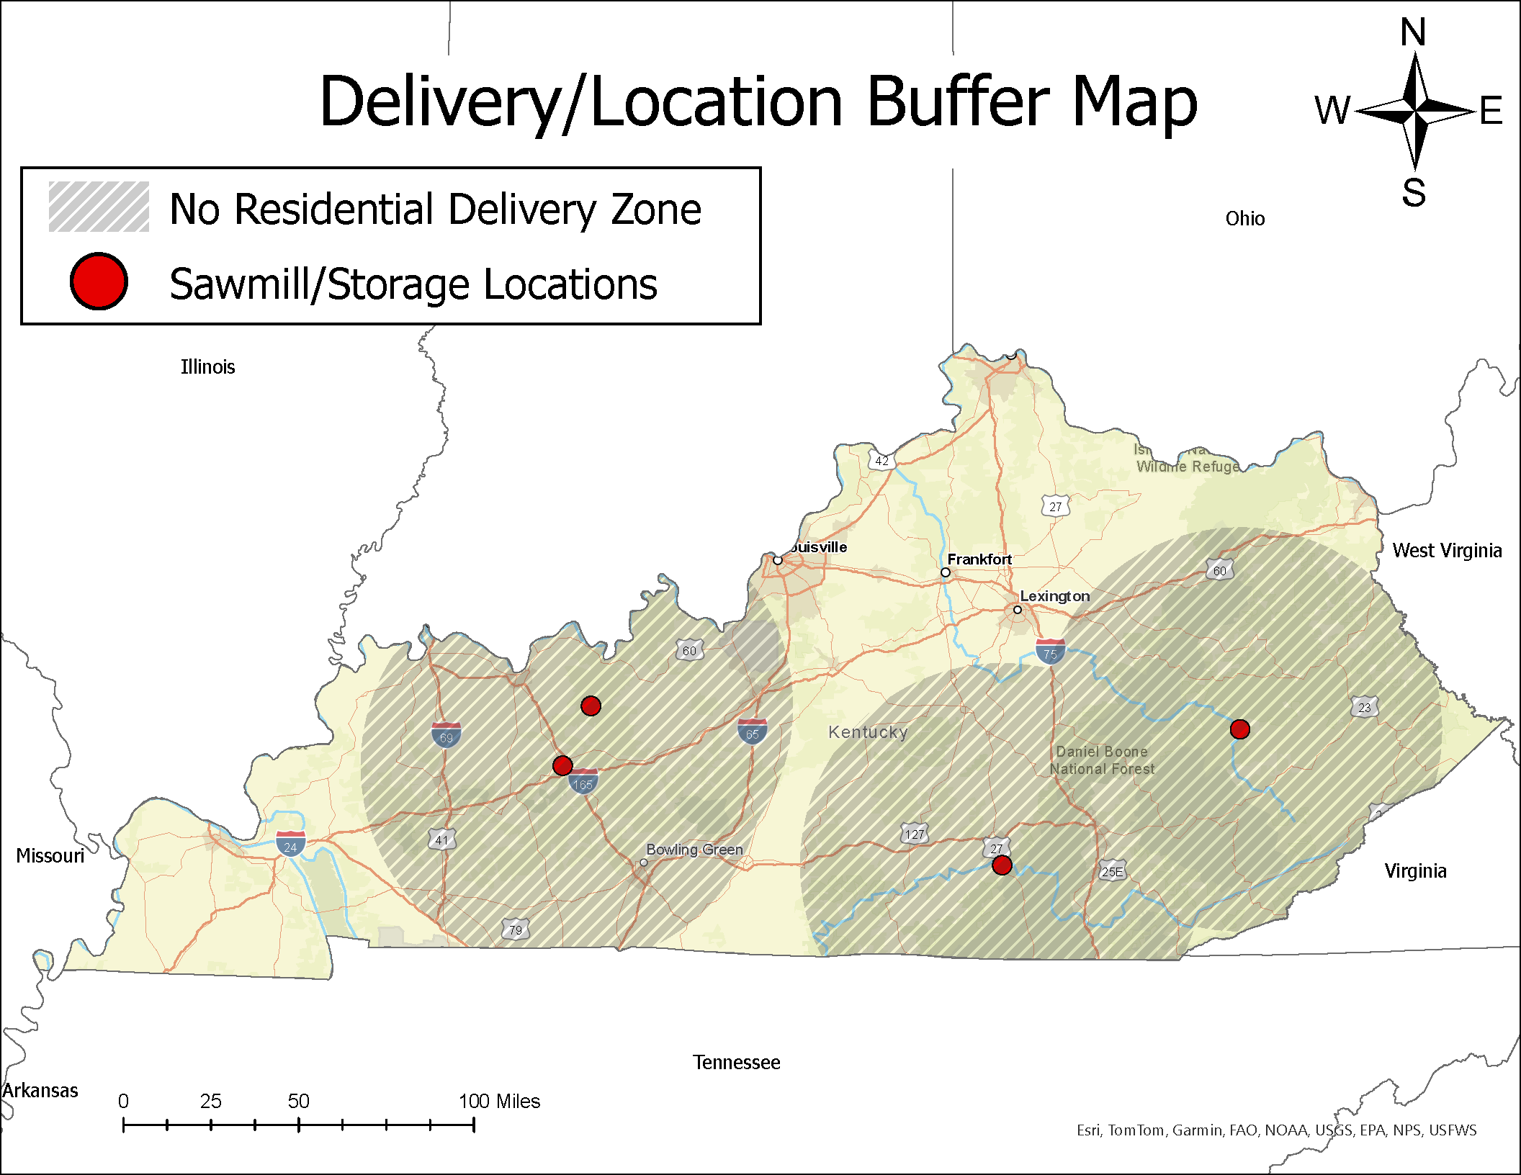

Slide 16

How is this Project Funded
The US Forest Service (USFS) Temporary Bridge Funding Opportunity Program (NOFO) through Wood Innovations provides grants for temporary bridge rental, loan, or cost-share programs. The program's goal is to protect water resources and reduce water quality degradation during forestry operations.

Slide 17
Eligibility
States and federally recognized Indian Tribes
Loggers and others working in forested areas
University Extension Department with State Forest Service Permission

Slide 18

Contact
Contact Michael Ammerman info
Kyloggingbridge@uky.edu or Michael.ammerman@uky.edu

Slide 19
Database Development and Hosting
The primary goal of this map is to effectively communicate the impact of these bridges in reducing stream sediment, while also showing their locations, in a way that is easily accessible to the public. The system is designed to be user-friendly, allowing individuals with minimal background in databases or mapping to update both the database and the map simultaneously. This is accomplished through an HTML web form that inputs data into a MySQL database hosted on GoDaddy.com, using the PHP MySQLi plugin for seamless integration.

Slide 20
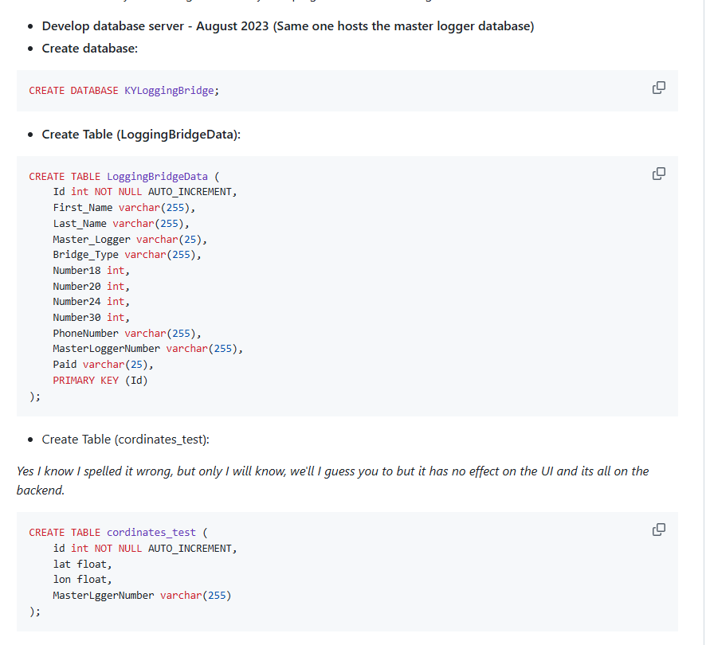
Setting Up Database
Create Database
Create Table
Create Table (Second)

Slide 21
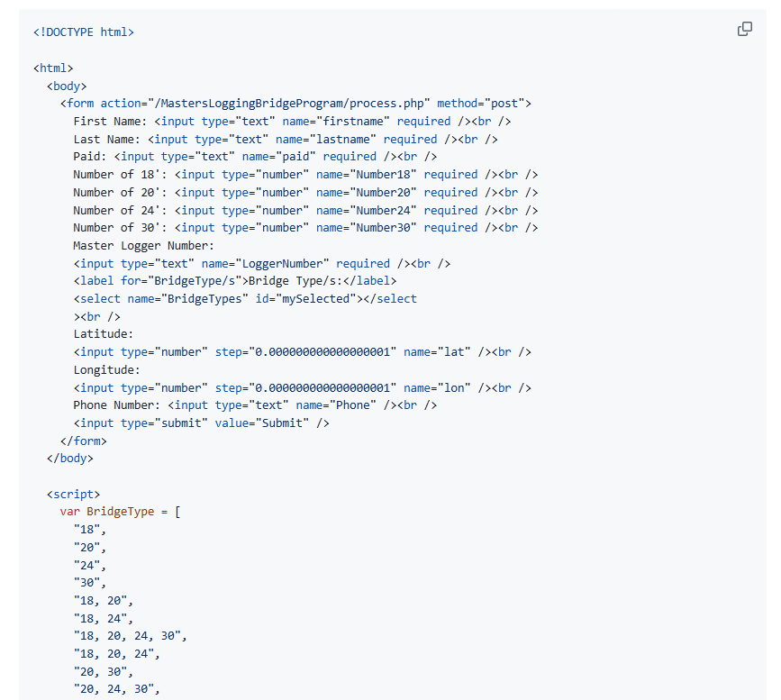
Form Development (First One)
Develop a Web Form to seamlessly update data and make it easy for the admin of the program (who has no experience with databases) to easily update the database. This one is designed to update the bridge data table
Develop SQL and PHP code to insert submitted into database
Number18 - represents the number of 18 foot bridges that have been purchased
Number20 - represents the number of 20 foot bridges that have been purchased
Number24 - represents the number of 24 foot bridges that have been purchased
Number30 - represents the number of 30 foot bridges that have been purchased

Slide 22
Develop SQL Code
INSERT INTO LoggingBridgeData(First_Name, Last_Name, Master_Logger, Bridge_Type, Number18, Number20, Number24, Number30, PhoneNumber, MasterLoggerNumber, Paid)
VALUES (Value1, Value2, Value3, Value4, Value5, Value6, Value7, Value8, Value9, value10, value11);

Slide 23
Adjust SQL Code to Adjust for PHP
$sql = "INSERT INTO LoggingBridgeData (LoggingBridgeData.First_Name, LoggingBridgeData.Last_Name, LoggingBridgeData.Master_Logger, LoggingBridgeData.Bridge_Type, LoggingBridgeData.Number18, LoggingBridgeData.Number20, LoggingBridgeData.Number24, LoggingBridgeData.Number30, LoggingBridgeData.PhoneNumber, LoggingBridgeData.MasterLoggerNumber, LoggingBridgeData.Paid) VALUES ('$firstName', '$lastName', '$paid', '$number18', '$number20', '$number24', '$number30', '$masterLoggerNumber', '$bridgeType', '$masterLoggerNumber', '$bridgeType', '$lat', '$lon', '$phoneNumber');"; // insert values into database
$results = mysqli_query($conn,$sql); // runs query to web database

Slide 24
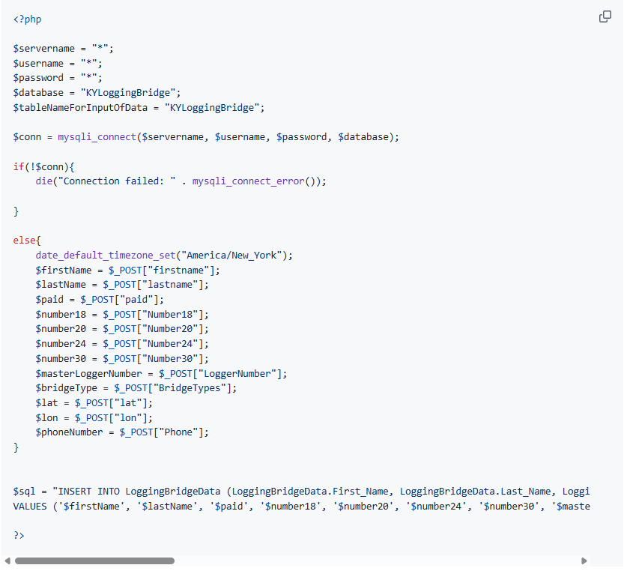
PHP insert form

Slide 25
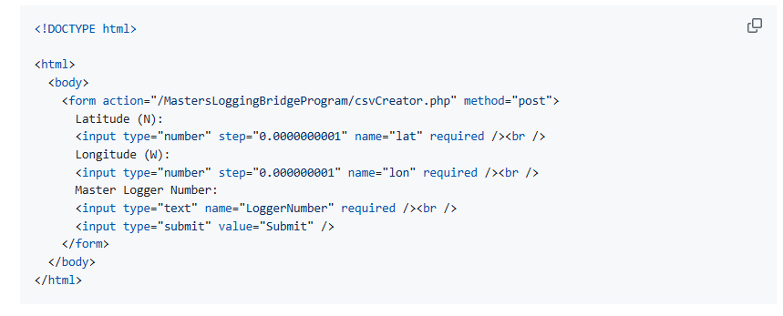
Develop Web Form to Insert Coordinates into Database

Slide 26
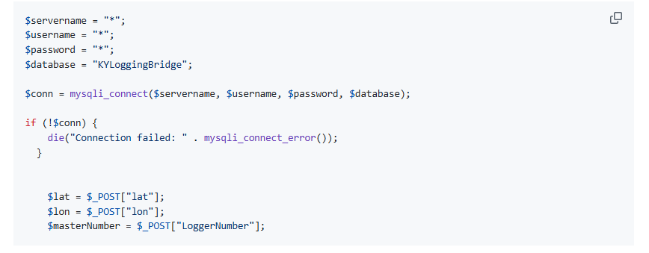
Develop Action Page

Slide 27
Develop SQL Code
INSERT INTO cordinates_test (cordinates_test.lat, cordinates_test.lon, MasterLggerNumber) VALUES ('$lat', '$lon', '$masterNumber');

Slide 28
Adjust SQL Code
$sql = "INSERT INTO cordinates_test (cordinates_test.lat, cordinates_test.lon, MasterLggerNumber)
VALUES ('$lat', '$lon', '$masterNumber');"; // insert values into database
$results = mysqli_query($conn,$sql);

Slide 29
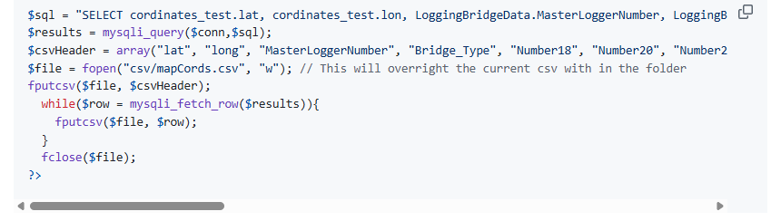
Create CSV through PHP using data from the database with two separate tables for seamless integration into the web-map. This query uses a left join to combine data from the two tables within the database. This is so that we can track changes of bridge locations without having to add new entries into the table set with purchaser data
SELECT cordinates_test.lat, cordinates_test.lon, LoggingBridgeData.MasterLoggerNumber, LoggingBridgeData.Bridge_Type, LoggingBridgeData.Number18, LoggingBridgeData.Number20, LoggingBridgeData.Number24, LoggingBridgeData.Number30 FROM cordinates_test LEFT JOIN LoggingBridgeData ON cordinates_test.MasterLggerNumber = LoggingBridgeData.MasterLoggerNumber;

Slide 30
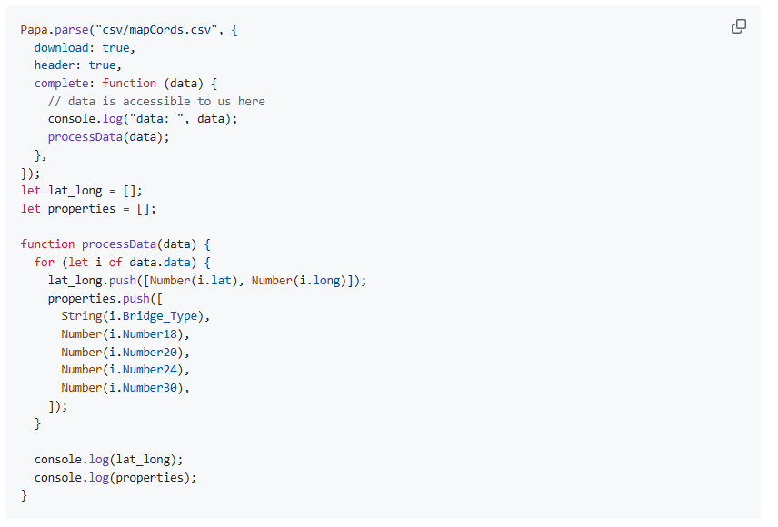
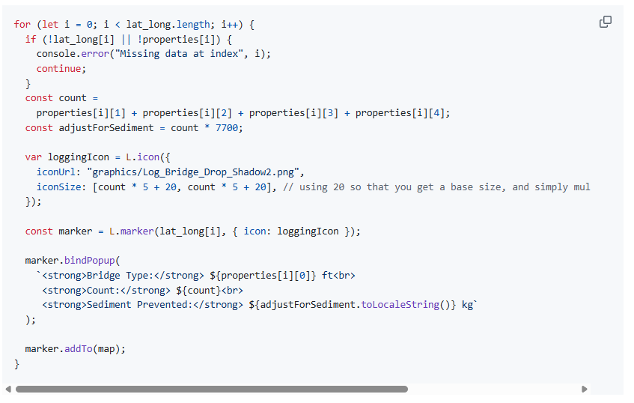
CSV into PapaParse and Then Push into a Marker Icon

Slide 31
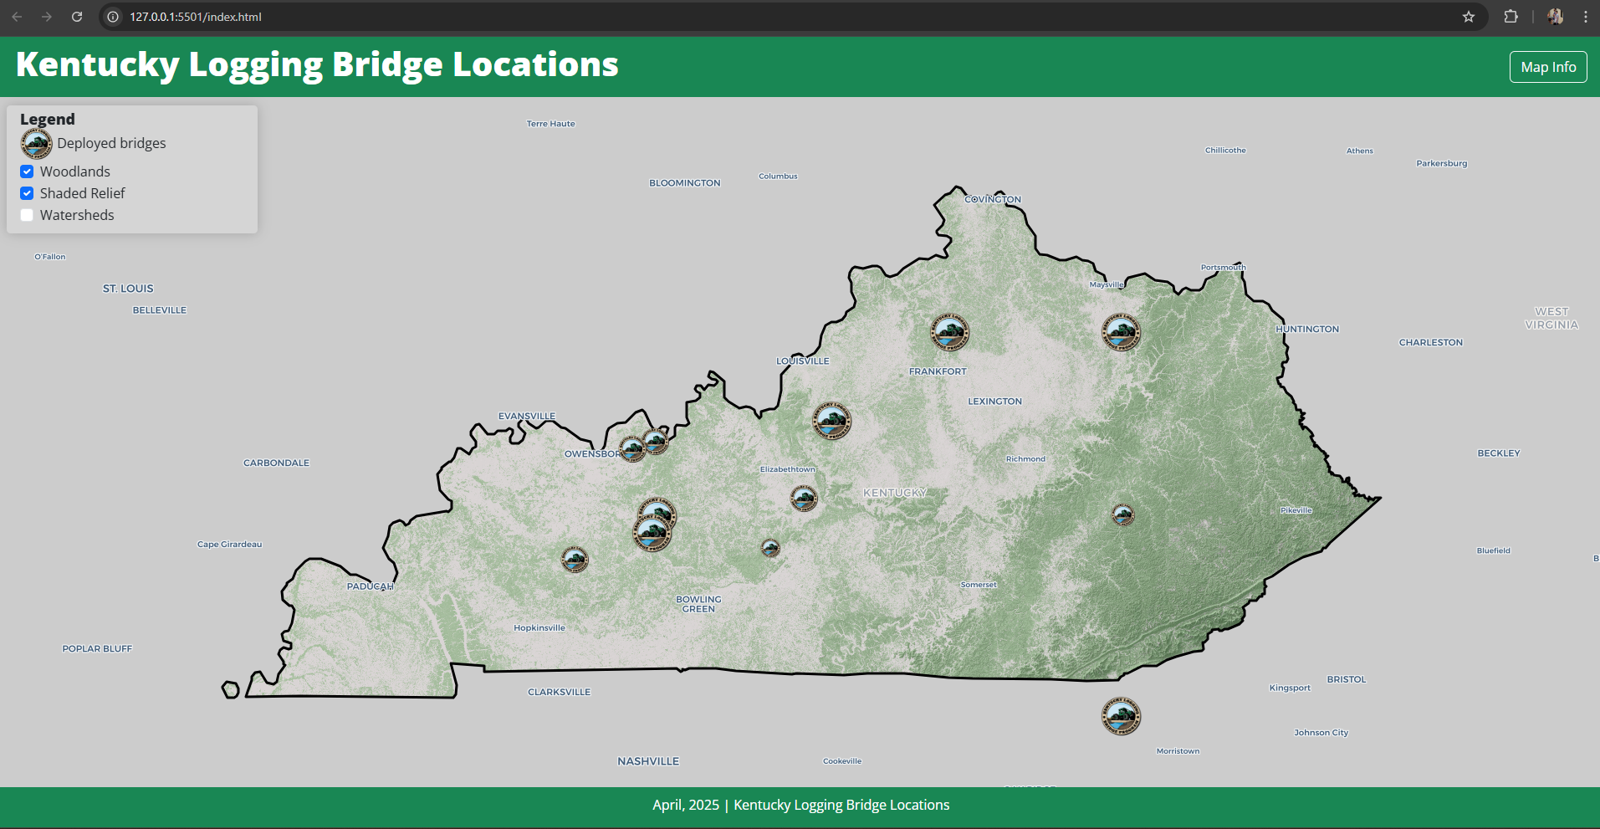

Slide 32
Questions?

